Slide 1
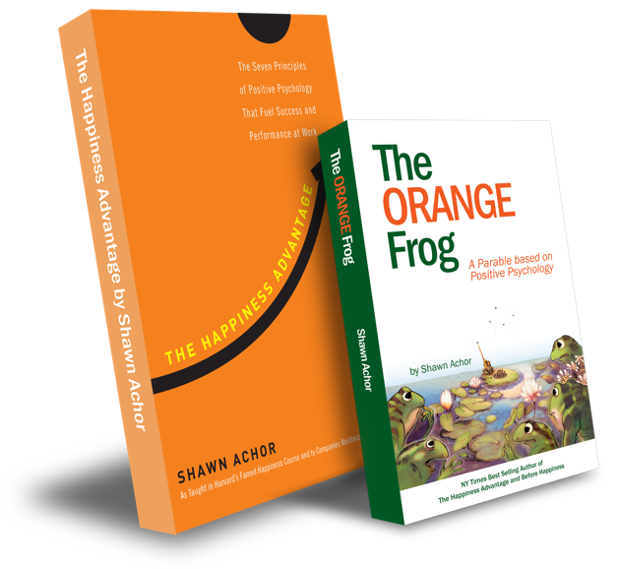
Conscious Acts
Of
Kindness

Slide 2
Week One

Slide 3
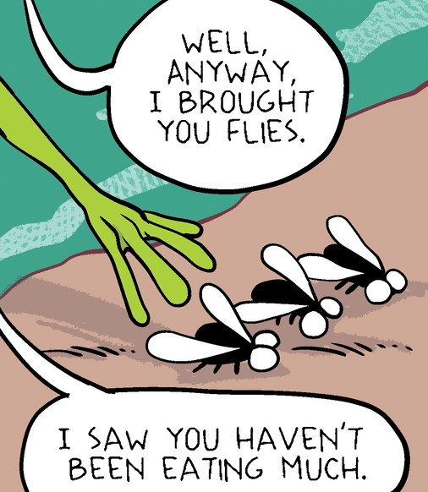
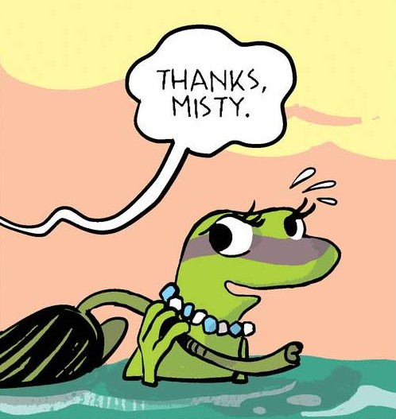
Conscious Acts of Kindness
Learning Objective:
I can identify what a Conscious Act of Kindness is.
I will discuss the importance of strategically being kind to others.
Notes:
Standard:
Essential Concept and/or Skill: Communicate and work productively with others emphasizing collaboration and cultural awareness to produce quality work.
Interact positively as a team member.
Cooperate with others in a group setting.
Generate ideas with group members.
Are active listeners.
Read and understand information in a variety of forms.
Express ideas.
Skill:
Active listening, express ideas

Slide 4
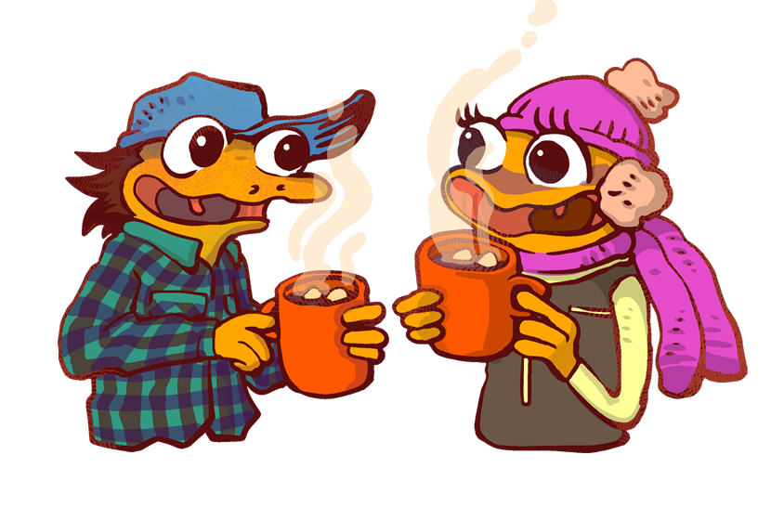
Skills
Relationship skills
Social awareness

Slide 5
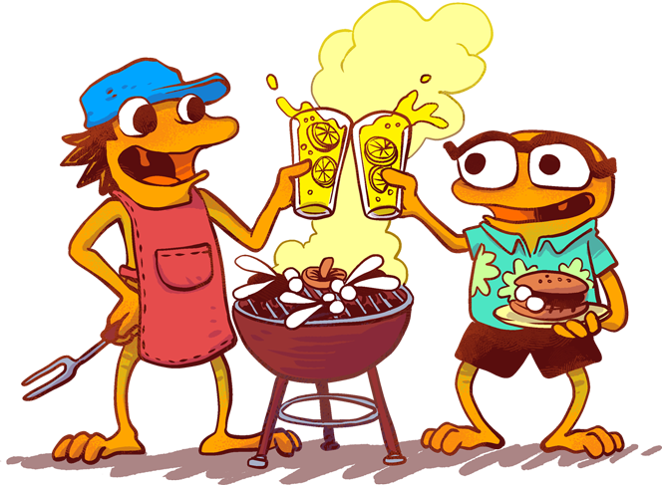
Opening Questions:
What does it mean to be kind?
In what ways are you kind?

Slide 6
Thoughts
Being kind on purpose is a great idea. According to the dictionary -- to be kind, means having or showing a gentle nature and a desire to help others. Sometimes this can seem like a chore. Other times, it’s simple and effortless.
When we take the time to be kind to others, it can lead to kindness spreading to others. There is a difference between being kind on purpose and being kind accidently. When we are kind on purpose there can be a big impact.

Slide 7
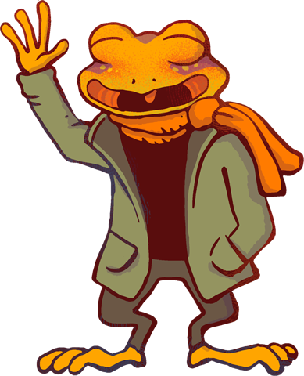
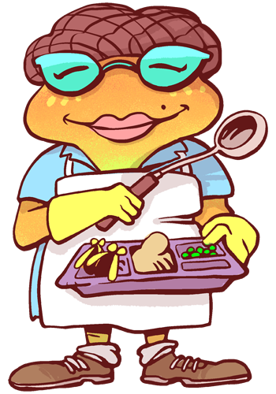
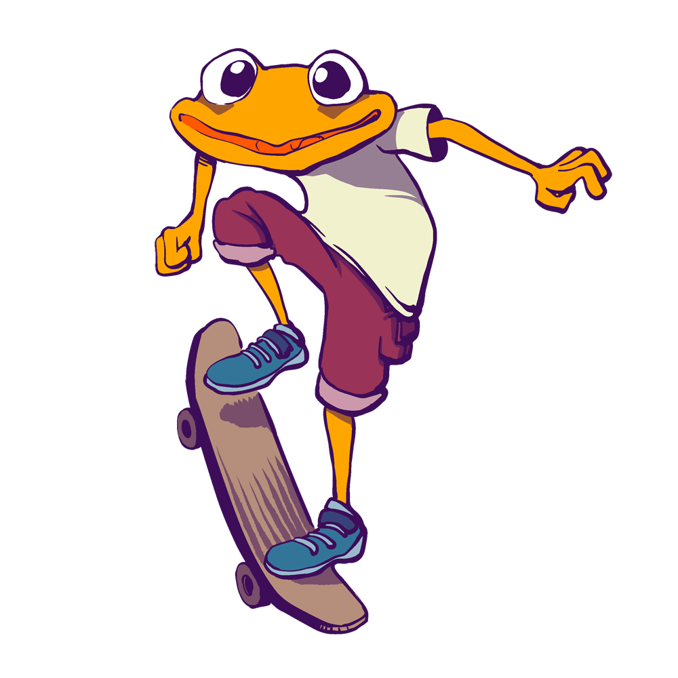
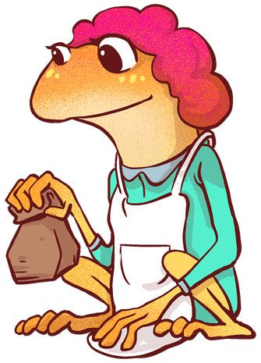
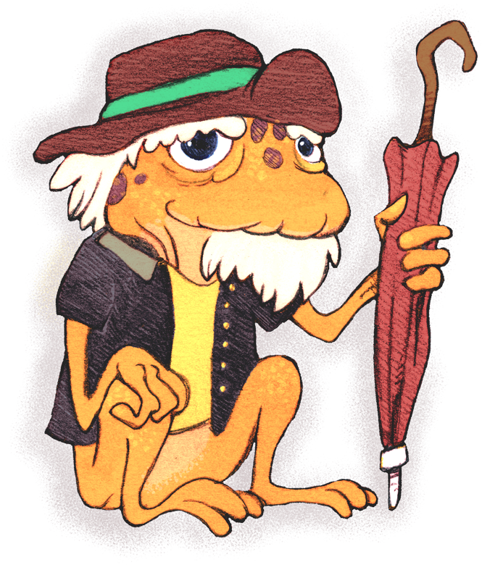
Activity
Think of someone in your life you could be kind to, on purpose.
Who could use your kindness to inspire them to have a great day?
Today, we are going to send an email to a person we care about.
When you are typing, we want to make sure that you are giving great, positive thoughts to the person.
Think of happiness and love for that person.

Slide 8
Bonus Question:
Who have you shown kindness to lately and how?
Framing a sentence. List 2-3 reasons why you care about a person.
I care about___________ because _______________.

